Slide 1
SOFTWARE ENGINEERING
Course Outline
Software Design Concept
Modularity
Coupling
Cohesion
Dr Prabhat Kumar Vishwakarma

Slide 2
SOFTWARE ENGINEERING
Software Design
The purpose of design is to prepare SDD(Software Design Document)
It is more creative activity than the analysis activity
We may think it as a problem solving activity
The framework of design activity is shown into the next slide
Dr Prabhat Kumar Vishwakarma

Slide 3
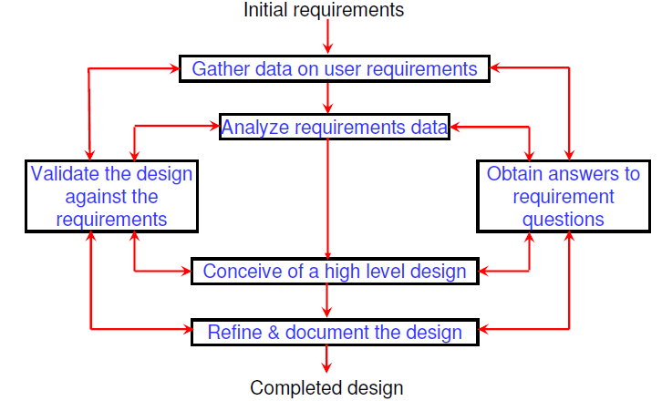
SOFTWARE ENGINEERING
Software Design Framework
Dr Prabhat Kumar Vishwakarma

Slide 4
SOFTWARE ENGINEERING
Software Design Process
Software design process is a two part design process
One is Conceptual design which deals with ‘WHAT’ aspects of Customer
Other is Technical design which deals with ‘HOW’ aspects of system Builder
Dr Prabhat Kumar Vishwakarma

Slide 5
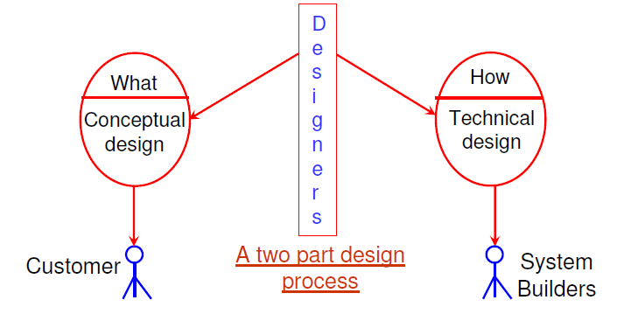
SOFTWARE ENGINEERING
Software Design Process
Dr Prabhat Kumar Vishwakarma

Slide 6
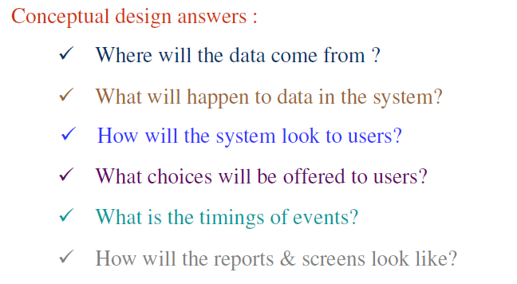
SOFTWARE ENGINEERING
Conceptual Design
Dr Prabhat Kumar Vishwakarma

Slide 7
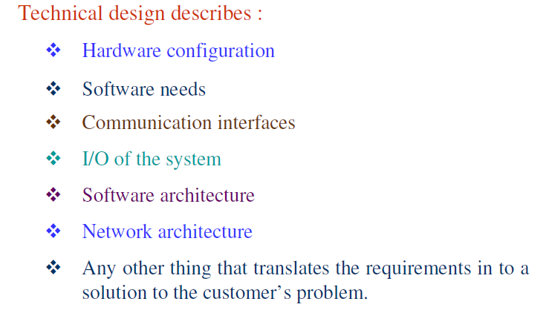
SOFTWARE ENGINEERING
Technical Design
Dr Prabhat Kumar Vishwakarma

Slide 8
SOFTWARE ENGINEERING
Modularity
Modularity is the single attribute of software that allows a program to be intellectually manageable.
It enhances design clarity, which in turn eases implementation, debugging, testing, documenting, and maintenance of software product.
Dr Prabhat Kumar Vishwakarma

Slide 9
SOFTWARE ENGINEERING
Coupling
Coupling is the measure of the degree of
interdependence between modules.
There are various types of coupling-
Data coupling
Stamp coupling
Control coupling
Common coupling
Content coupling
Now we shall discuss each type of coupling separately
Dr Prabhat Kumar Vishwakarma

Slide 10
SOFTWARE ENGINEERING
1.Data Coupling
The dependency between module A and B is said to be data coupled if their dependency is based on the fact they communicate by only passing of data. Other than communicating through data, the two modules are independent.
Dr Prabhat Kumar Vishwakarma

Slide 11
SOFTWARE ENGINEERING
2.Stamp Coupling
Stamp coupling occurs between module A and B when complete data structure is passed from one module to another.
Dr Prabhat Kumar Vishwakarma

Slide 12
SOFTWARE ENGINEERING
3.Control Coupling
Module A and B are said to be control coupled if they communicate by passing of control information. This is usually accomplished by means of flags that are set by one module and reacted upon by the dependent module.
Dr Prabhat Kumar Vishwakarma

Slide 13
SOFTWARE ENGINEERING
4.Common Coupling
With common coupling, module A and module B have shared data. Global data areas are commonly found in programming languages. Making a change to the common data means tracing back to all the modules which access that data to evaluate the effect of changes.
Dr Prabhat Kumar Vishwakarma

Slide 14
SOFTWARE ENGINEERING
5.Content Coupling
Content coupling occurs when module A changes data of module B or when control is passed from one module to the middle of another.
Dr Prabhat Kumar Vishwakarma

Slide 15
SOFTWARE ENGINEERING
Cohesion
Cohesion is a measure of the degree to which the elements of a module are functionally related.
Dr Prabhat Kumar Vishwakarma

Slide 16
SOFTWARE ENGINEERING
Types of Cohesion
Functional cohesion
Sequential cohesion
Procedural cohesion
Temporal cohesion
Logical cohesion
Coincident cohesion
Dr Prabhat Kumar Vishwakarma

Slide 17
SOFTWARE ENGINEERING
1.Functional Cohesion
Module A and B are part of a single functional task. This is very good reason for them to be contained in the same procedure.
Dr Prabhat Kumar Vishwakarma

Slide 18
SOFTWARE ENGINEERING
2.Sequential Cohesion
Module A outputs some data which forms the input to B. This is the reason for them to be contained in the same procedure.
Dr Prabhat Kumar Vishwakarma

Slide 19
SOFTWARE ENGINEERING
3.Procedural Cohesion
Procedural Cohesion occurs in modules whose instructions although accomplish different tasks yet have been combined
because there is a specific order in which the tasks are to be completed.
Dr Prabhat Kumar Vishwakarma

Slide 20
SOFTWARE ENGINEERING
4.Temporal Cohesion
Module exhibits temporal cohesion when it contains tasks that are related by the fact that all tasks must be executed in the same time-span.
Dr Prabhat Kumar Vishwakarma

Slide 21
SOFTWARE ENGINEERING
5.Logical Cohesion
Logical cohesion occurs in modules that contain instructions
that appear to be related because they fall into the same logical class of functions.
Dr Prabhat Kumar Vishwakarma

Slide 22
SOFTWARE ENGINEERING
6.Coincident Cohesion
Coincidental cohesion exists in modules that contain instructions that have little or no relationship to one another.
Dr Prabhat Kumar Vishwakarma

Slide 23
SOFTWARE ENGINEERING
Relationship between Coupling and Cohesion
If the software is not properly modularized, a host of seemingly
trivial enhancement or changes will result into death of the project. Therefore, a software engineer must design the modules with goal of high cohesion and low coupling.
Dr Prabhat Kumar Vishwakarma

